Slide 1
REPLICATION OF T4 PHAGE
MANJU PHADKE

Slide 2
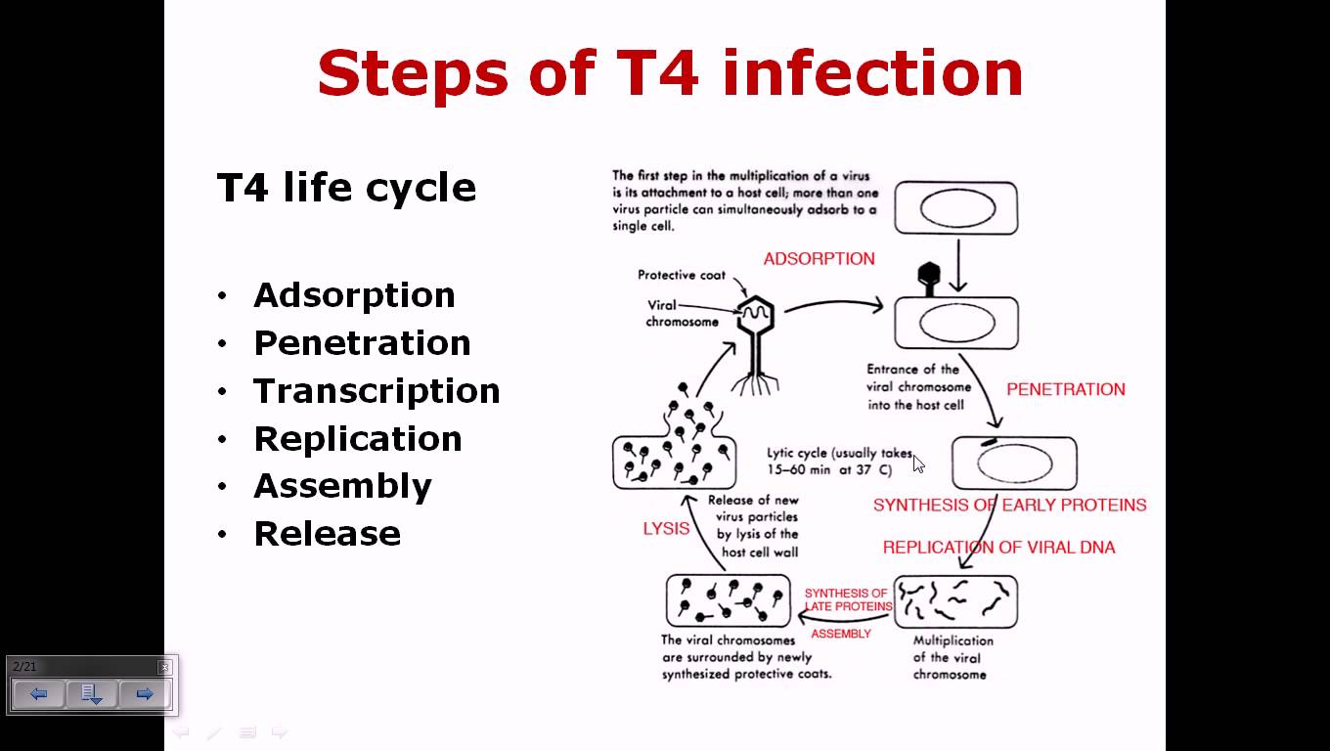

Slide 3
ONE STEP GROWTH CURVE
Experiment developed by Max Delbruck and Emory Ellis
Reproduction of a large phage population is synchronized so that the molecular events occurring during reproduction can be followed
E coli mixed with coliphage , allowed to attach to the host
Culture is then diluted so that any new phage particle released uupon lysis of host will not infect another cell
Number of infective phage particles released is determined at various intervals by plaque assay

Slide 4
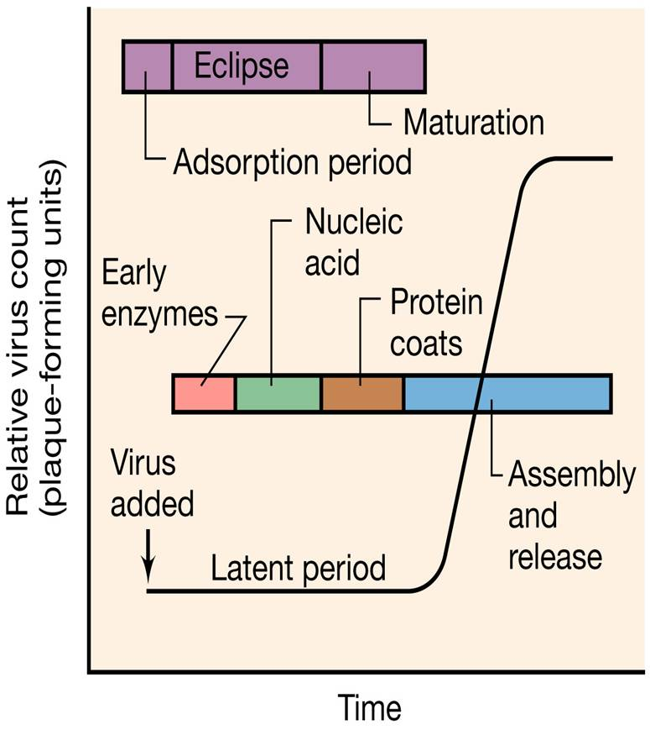
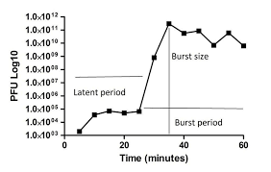

Slide 5
Phases of One step growth curve
Latent phase: No release of virions. Shortest time required for virus production and release.
Eclipse period: Initial segment of Latent phase, as virions were detectable before infection, but are now concealed or eclipsed
Rise period or Burst: Host cells rapidly lluse and release infective virions
Plateau: No more Viruses liberated as all host cells are killed
Burst size: Total number of virus particles produced per infected cell

Slide 6
Adsorption to the host cell and penetration
Adsorb to receptors, nature varies with phage.
cell wall, lipopolysaccharides and proteins. Techoic acids, flagella, pili can serve as receptors
T even phage adsorption requires tail fibres
As more fibres adsorb, baseplate settles down
Binding by electrostatic attraction, influenced by Ca+2 and Mg+2
Conformational changes occur in base plate and sheath, tail sheath shortens to form cylinder, 24 rings long to 12 rings long

Slide 7
Sheath becomes shorter and wider
Central tube or core pushd through bacterial wall
Base plate contains protein gp5 with lysozyme activity that helps in penetration of tube through peptidoglycan layer of bactria
DNA extruded through the tail tube into the host cell
Tube interacts with plasma membrane to form a pore through which the DNA passes

Slide 8
T4 DNA shows terminal redundancy, base sequence is repeated at both ends of the molecule
When many DNA copies have been made, 6-10 copies are joined by the redudndant ends by enzymes and made into long strands called concatamers
During assemble, concatamers are cleaved in such a way that the genome is slightly longer than the t4 Gene set

Slide 9
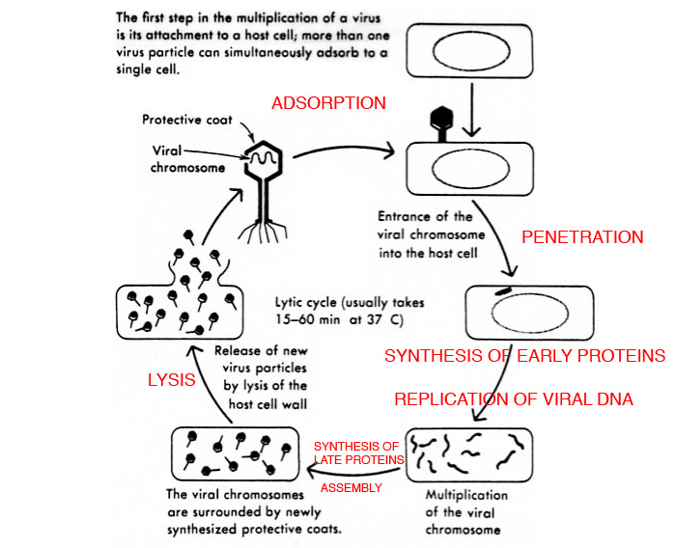

Slide 10
Assembly of Phage particles
Complex self assembly process
Late mRNA produces three type of proteins: Phage structural proteins, proteins that help with phage assembly, proteins involved in cell lysis and phage release
Late mRNA transcription: 9 minutes afterT4 injection
Base plate made up of 15 gene products
Tail tube built on plate, sheath assembled around it
Phage prohead or procapsid made of 10 proteins, produced separately, assembled with the help of scaffolding proteins that are degraded after construction is complete

Slide 11
Tail fibers attach to baseplate after head and tail have come together
Long concatamer enters head until it is full, then the concatamer is cut.
Complete T4 particles appear 15 minutes after infection

Slide 12
Release of Phage particles
E Coli cell lyses takes place 22 minutes after infection
Several genes involved in the process of release
One gene directs synthesis of Endolysin that attacks the cell wall peptidoglycan
Holin, a phage protein, produces plasma membrane lesion, stops respiration and allows the endolysin to attack peptidoglycan

Slide 13
